Slide 1

Bridging the Gap:
A University Alumni Connect Web App
A proposal for a dynamic, multi-faceted platform designed to foster stronger connections between current students and successful alumni, enhancing career opportunities and community engagement.

Slide 2


The Mission: Strengthening the University Ecosystem
Our goal is to create a vibrant digital hub that serves as a continuous resource for students and a valuable channel for alumni to give back to the institution. This platform is built on three core pillars:
Fostering Connections
Enhancing Careers
Building Community
Facilitating meaningful professional networking between the two groups.
Providing exclusive access to jobs, internships, and mentorship opportunities.
Creating a centralised space for university events and updates.

Slide 3





Technological Foundation: Robust and Scalable
Our application is built using a modern, reliable, and scalable technology stack to ensure performance, security, and a seamless user experience across all devices.
Front-end
Back-end
HTML5, CSS3, JavaScript
Django (Python Framework)
Database
Authentication
Firebase for Real-time Data
LinkedIn OAuth for seamless, verified login
Leveraging Django ensures rapid development and high security, while Firebase supports the real-time functionality of the chat system.

Slide 4
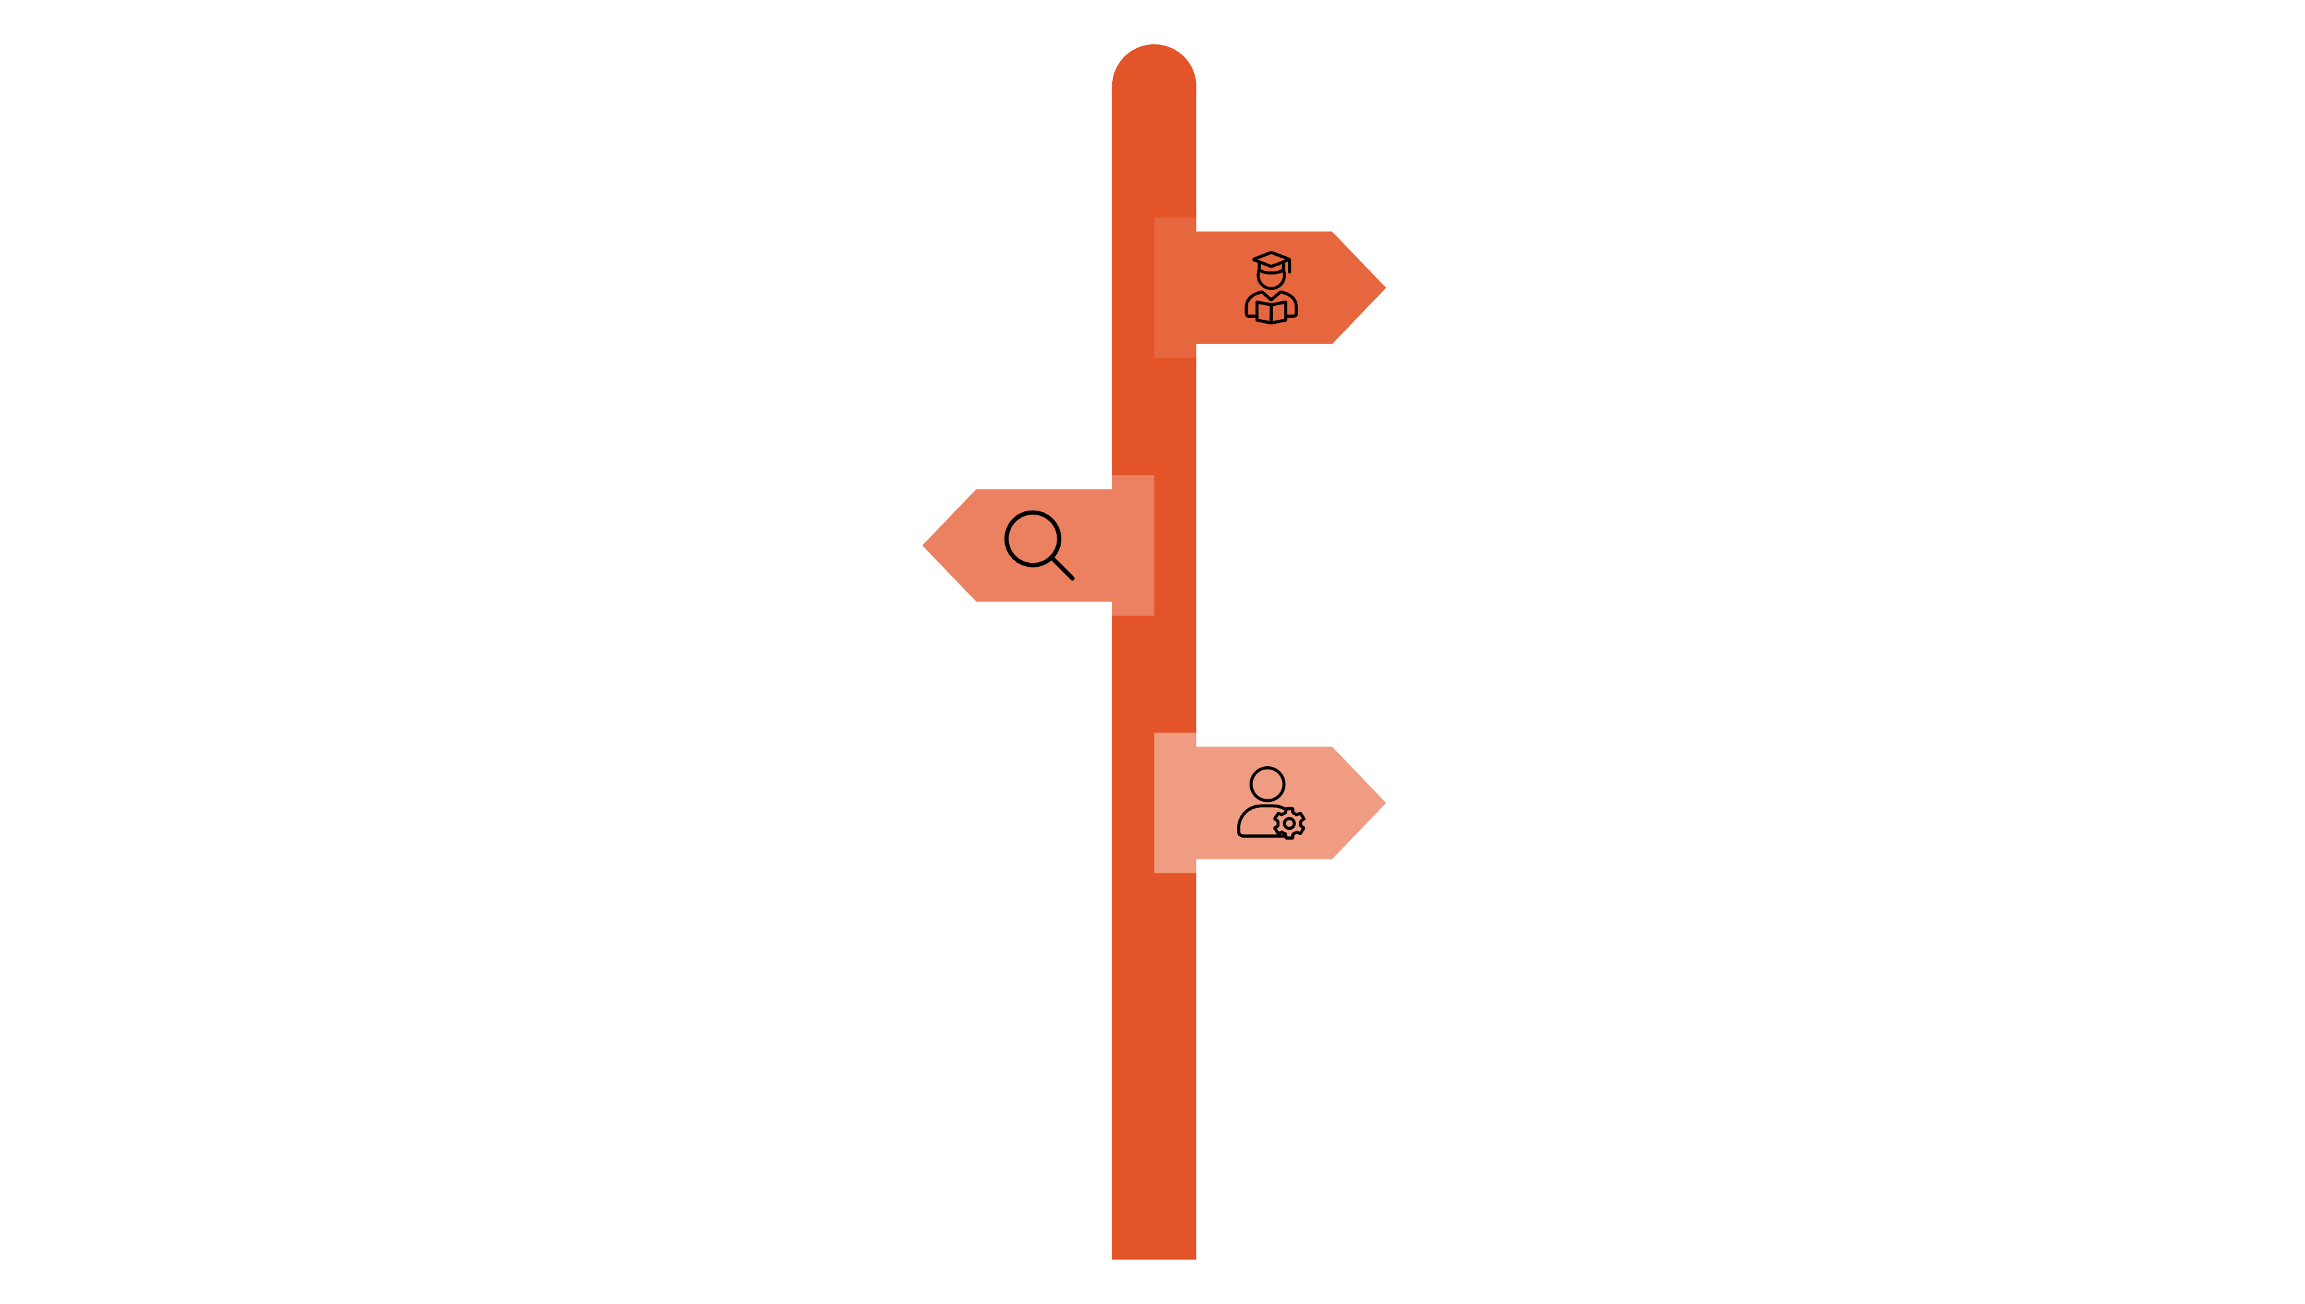



Platform Architecture: Three Distinct User Experiences
The web application is structured around three primary user roles, each with a tailored interface
and specific functionalities to meet their unique needs.
Student Page
(Communication with
alumnus,events,Alumni
directory.)
Alumni Page
(connecting with
students,events,posting job
offerings/internships)
Admin Page
(Manage users, content, and settings.)

Slide 5




Student Page: Navigating Career Pathways
Key Features for Students
The student interface is focused on connectivity, learning, and engagement, ensuring they have the tools to launch their professional lives.
Direct Chat System:
Connect instantly with alumni mentors for advice,
guidance, and industry insights.
Events Calendar:
Stay updated on career workshops, alumni meetups,
and university functions.
Detailed Profile:
Showcase academic achievements, skills, and career
interests to attract alumni connections.

Slide 6



Alumni Page: Give Back and Recruit
The alumni interface leverages their professional experience, offering them powerful tools for recruitment, mentorship,
and community service.
Networking & Chat
Job & Internship Postings
Events & Profile
Maintain and expand professional networks while offering guidance to current students.
Directly post exclusive job and internship openings within their companies to the student body.
Manage personal profile details and RSVP for alumni-specific and university-wide events.

Slide 7
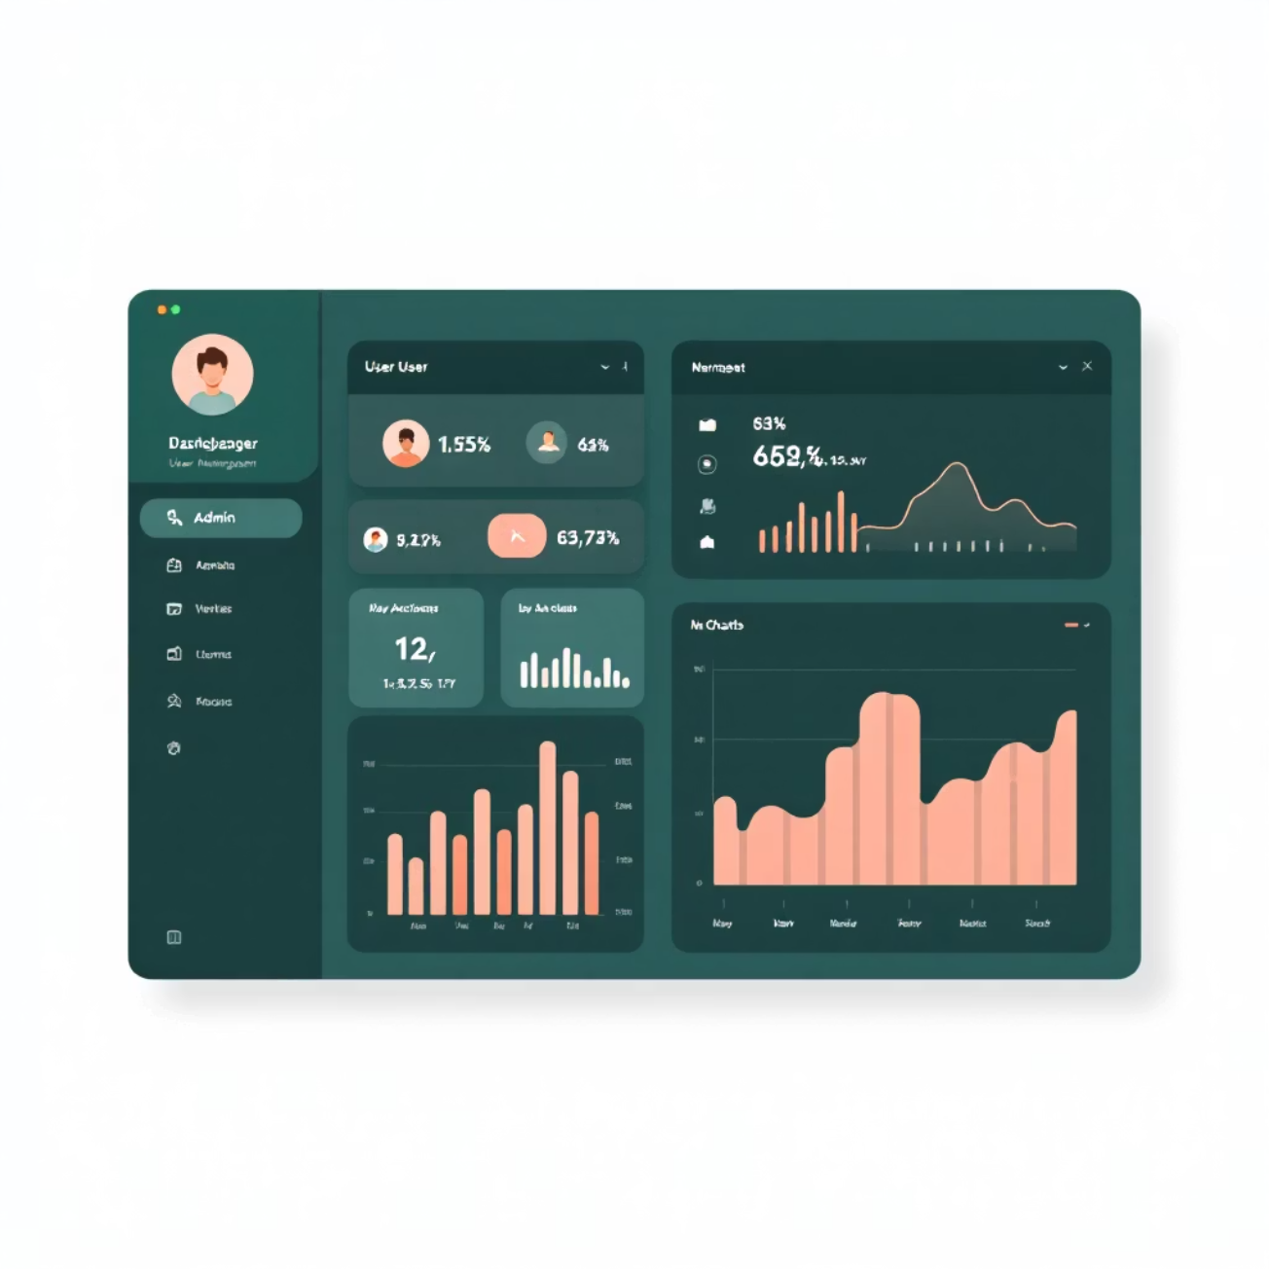
Admin Page: Centralized Management and Oversight
The Admin page ensures the smooth and secure operation of the entire platform, providing tools for user management and content moderation.
User Vetting and Approval
Content Moderation
Manage student and alumni verification processes to maintain a trusted professional environment.
Review and approve all job postings, events, and potentially sensitive communications.
System Monitoring
Oversee technical performance, user activity, and troubleshoot any platform issues.

Slide 8
Conclusion: Key Benefits for Future Growth
This platform is more than just a web app; it is an investment in the future success of our students and the enduring strength of the alumni network.
For Students
For Alumni & University
Direct access to industry professionals and verified job opportunities.
Efficient, targeted recruitment channel for top university talent.
Enhanced career preparedness through mentorship and real-world exposure.
Increased alumni loyalty and opportunities for philanthropic engagement.
Seamless transition from academia to professional life.
Strengthened university reputation and value proposition for prospective students.
The Alumni Connect Web App will transform our community connections into tangible career capital.

